Slide 1
C
H
A
M
P
S
S
Choosing Healthy Appetizing Meal Plan Solutions for Seniors
Presented by:
Connie Stankewsky
CHAMPSS Coordinator
Johnson County, Kansas
Area Agency on Aging
Notes:
I’m delighted to be here and excited to tell you about our CHAMPSS program which we implemented in 2008.This is a work in progress which began in 2006 and we continue to change and tweak as we go along. So my disclaimer here is that we don’t have all the answers but hopefully I can guide and a point of reference to start with.

Slide 2

What’s in it for you?
Discover a new twist, on a proven strategy for developing a non-traditional nutrition program.
Learn how to make it easy for your seniors to select tasty meal options while improving their health.
Identify results and lessons learned that will save you time and money in implementing a similar program.

Slide 3
Let’s Get Started!
Today’s topics include:
  Who we are
    (county, agency, nutrition program)
  Our traditional meal program
  The new system – what we thought would work
  The new system – what really works and why
  How we did it
    (research, contacts, contracts, costs, partners and resources)
  Marketing the program
  Measuring the results
  Awards and recognition

Slide 4
Who We Are
County
Agency
Nutrition Program

Slide 5
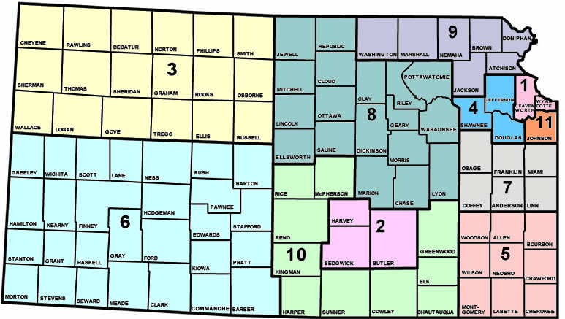
Where In The World Is
Johnson County, Kansas?
Notes:
So what and where is Johnson County? Well, it’s in Kansas, bordering Kansas City, Mo in the is located in the upper northeast corner of the state of Kansas bordering Kansas City, Mo.
Johnson County is PSA 11 located in the orange. The orange dot may not be very large but the population of Jo Co is 500,000 people. 55,000 are over the age of 65 and growing …we have many baby boomers in this suburban metropolitan area. Johnson County, PSA 11, is the only single county AAA in Kansas due to the heavy population of seniors in the area.

Slide 6
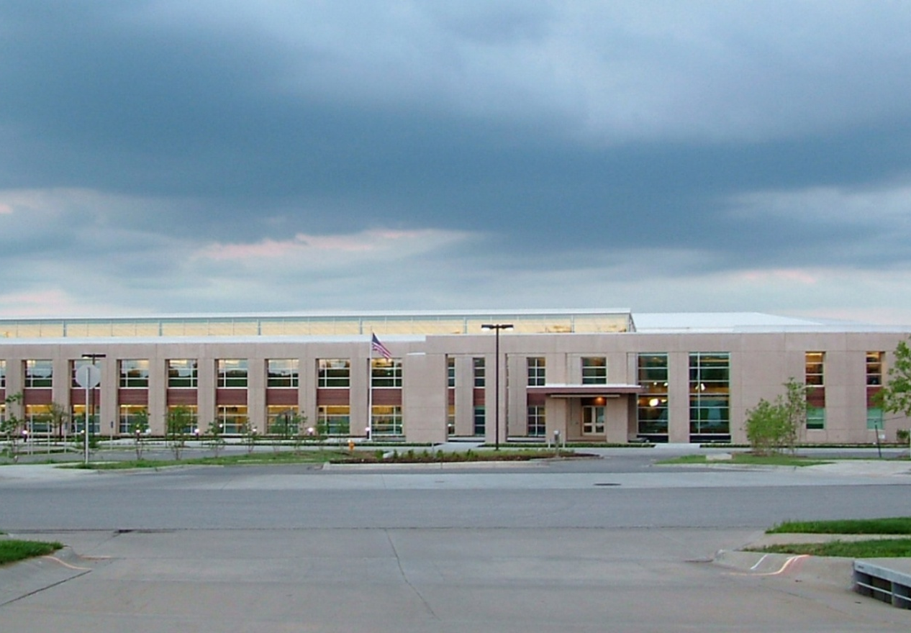
Johnson County
Human Services Department
.
Notes:
AAA is a dept. within a larger council of government – Human Services Dept.
First green building in Jo Co government. We are a part of county government and abide by their policies.
Johnson County Human Services - Johnson County Human Services is the agency of Johnson County government that provides programs and services to residents who are vulnerable because of restricted incomes, issues related to aging, or a disability. Programs are structured under five teams: The Area Agency on Aging, Housing Services, Outreach, Accessibility, and Information. The Human Services Dept. provides both safety-net and self-sufficiency services supporting clients’ independence and dignity.

Slide 7
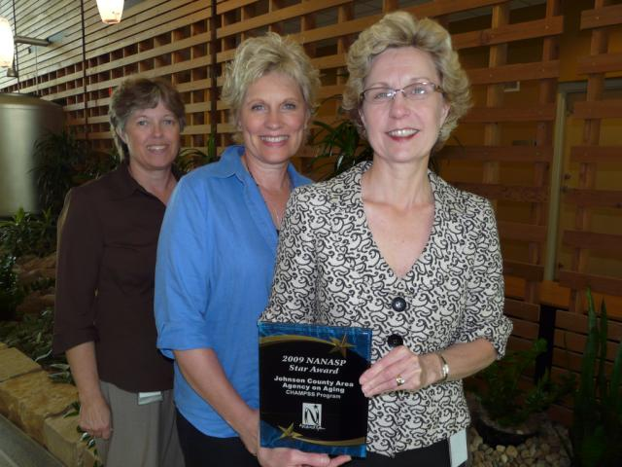
CHAMPSS Staff
Nancy Tanquary, RD, LD Nutrition Manager
Connie Stankewsky, CHAMPSS Coordinator
Debbie Summers, Assistant CHAMPSS Coordinator
Notes:
The CHAMPSS program would not work without the collaboration of three primary players involved. On a regular basis we are talking with participants, grocery store employees, and each other about this program.

Slide 8
Our Traditional Meal Program
Description
Participation
Monthly Menu
Limitations

Slide 9
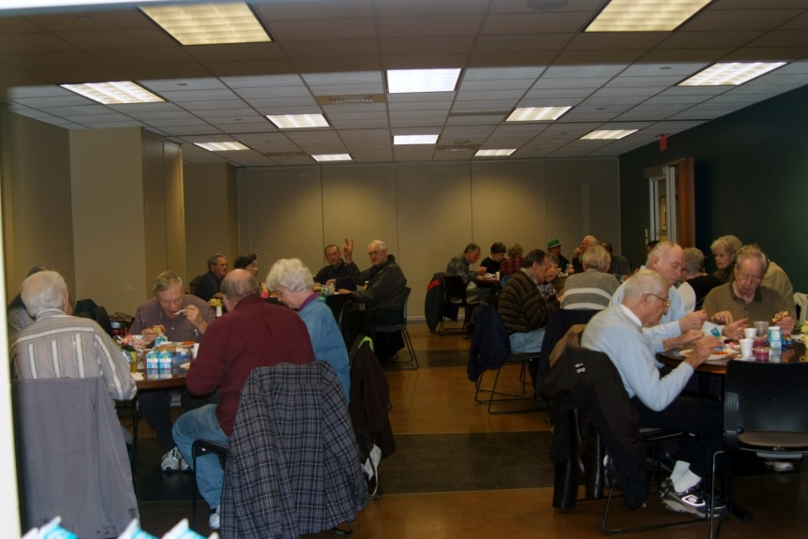
Johnson County
Traditional Nutrition Program
8 Neighborhood Centers
Meals served Monday thru Friday
Choice of entrée’
Open 4 hours per day
Average daily attendance 200 per day
Notes:
Traditional congregate programs

Slide 10
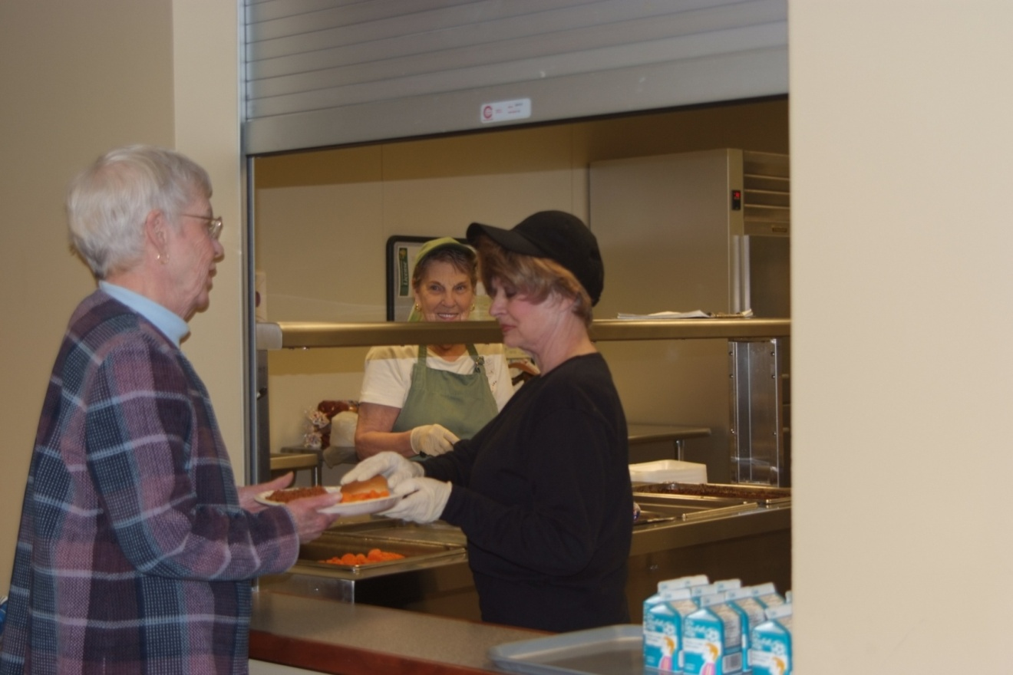
Overland Park
Neighborhood Center

Slide 11
Traditional Program Limitations
Limited dining hours
Limited menu choices
Delayed retirement for seniors reduces potential seniors served
Neighborhood center doesn’t appeal to some
Notes:
Traditional congregate programs

Slide 12
Time for Something New & Different
Discovering CHAMPSS
Program Benefits
Our 1st Location
Steps to Participation

Slide 13
Our Goals
Must have Choices
Must be Appetizing
Must be Healthy
Must be complete Meal Plan
Must be a Solution for Seniors
That spells CHAMPSS
Notes:
Our goal for a new program was to offer choice and flexibility via a partnership with another food service operation. Time for something new and different to attract younger seniors but also be useful to the older crowd.
Must have choices
Must be healthy
Must be appetizing
Must be a meal plan
Must be a solution for seniors
That spells CHAMPSS
AAA Strategic Plan
Objective
I.1.d. Increase number and types of non-traditional congregate meal programs, and decrease traditional congregate programs according to needs and desires of customers.

Slide 14
What is “CHAMPSS?”
    Choosing Healthy Appetizing
    Meal Plan Solutions for Seniors
Notes:
What else is CHAMPSS? It’s a new way to serve the nutritional and social needs of older adults. We challenged ourselves to think outside the box. What we came up with was a non-traditional congregate program.

Slide 15
Benefits of “CHAMPSS”
    A new way of serving the nutritional and social needs of adults 60 or over.
Voucher Programs
  A payment method for services provided under an agreement
  with appropriate eating establishments in the community
Choice
  Seniors can choose a variety of nutritious items from the 5 food groups
Convenience
  Seniors can eat anytime from 8am to 7pm, seven days a week at their local Hy-Vee Grocery Store
Maximized Resources
  Increased number of seniors served by partnering with grocery store.
Notes:
What else is CHAMPSS? It’s a new way to serve the nutritional and social needs of older adults. We challenged ourselves to think outside the box. What we came up with was a non-traditional congregate program.

Slide 16
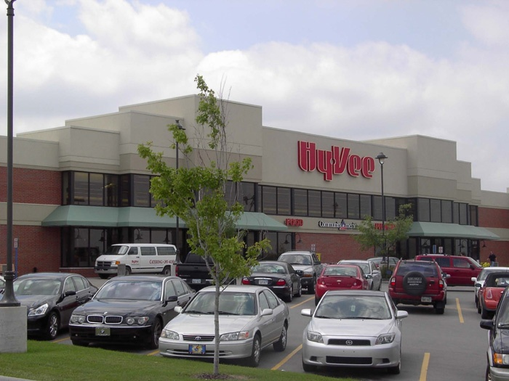
1st CHAMPSS - April 14, 2008
New store selection process
Dietitian on site
Health oriented
Food court system
Large dining area
Location
Notes:
So …..we partnered with Hy-Vee which is a grocery store. As you can see it’s lovely. It’s a chain and there are Hy-Vee grocery stores throughout our county. So why Hy-Vee? Several reasons. First, this store has a dietitian that I work closely with which is extremely helpful. Second, Hy-Vee stores are health oriented. Third, the store is right across the street from our office building. You couldn’t ask for more convenience then that for a new program. Fourth, this store has a food court system with a large dining area. Lastly, Hy-Vee’s focus is to make their customers lives, easier, happier, and healthier. We believe in their mission and feel it was in line with ours.
.

Slide 17
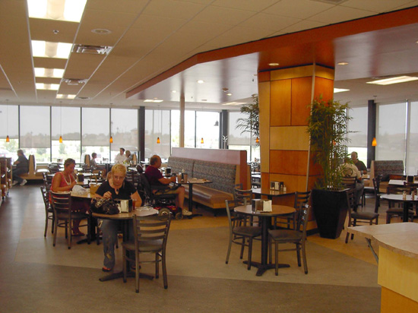

Dining Area – 1st Store
Notes:
So …..we partnered with Hy-Vee which is a grocery store. As you can see it’s lovely. It’s a chain and there are Hy-Vee grocery stores throughout our county. So why Hy-Vee? Several reasons. First, this store has a dietitian that I work closely with which is extremely helpful. Second, Hy-Vee stores are health oriented. Third, the store is right across the street from our office building. You couldn’t ask for more convenience then that for a new program. Fourth, this store has a food court system with a large dining area. Lastly, Hy-Vee’s focus is to make their customers lives, easier, happier, and healthier. We believe in their mission and feel it was in line with ours.
.

Slide 18
The New System
3 Easy Steps…..We Thought Would Work
The New System – What Really Works
Benefits
Step-by-Step Instructions

Slide 19
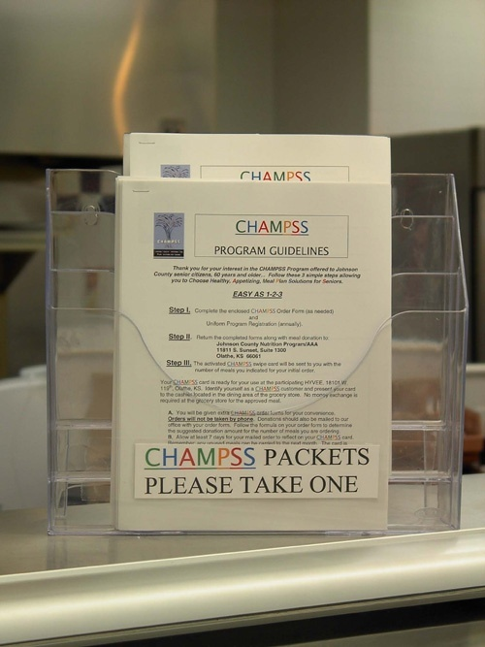
Easy as 1-2-3 (We Thought……)
Step 1
Complete the enclosed CHAMPSS Order Form and
Uniform Program Registration (annually).
Step 2
Return the completed forms along with meal donation.
Step 3
The activated CHAMPSS swipe card will be sent to you with the number of meals you indicated for your initial order.
Notes:
In the beginning we made presentations at the senior centers and talked with groups of people at the high rises as a way of marketing. After the initial roll out of the program we decided to make the information available at the grocery store…making it as user friendly for the seniors as possible. This was adequate when working with 1 store but as the program grew and people were sharing the information we realized that we needed a better system. Besides, we were spending hours on the telephone explaining one on one how the program worked and answering questions. When the 2nd location was launched we changed our system to enrollment sessions.
So now we had to develop information for participants regarding how the CHAMPSS program worked. We have packets which consists of 3 forms and an envelope. This is the first form. The program guidelines … which are easy as 1-2-3. It spells out exactly what a potential participant needs to do to sign-up for the program. Fill out he order form & the assessment and send it to our office address hopefully with a donation. All processing of CHAMPSS paperwork takes place at the main nutrition program office.
1.Being able to walk the seniors thru the process
2.sharing some nutrition education with them
3.talking about healthy choice and
4. finally the importance of donations
We have found we have far fewer problems, questions, concerns from the seniors. Plus it’s exciting to see how many seniors are interested in eating healthy.

Slide 20
Lessons Learned
CHAMPSS Order Form and
Uniform Program Registration received with incomplete info.
Inconsistent / incorrect program info provided by friends and professionals to prospective new participants.
Excessive administrative time spent providing one-on-one correct info.
Unpredictable growth in number of participants.
Notes:
In the beginning we made presentations at the senior centers and talked with groups of people at the high rises as a way of marketing. After the initial roll out of the program we decided to make the information available at the grocery store…making it as user friendly for the seniors as possible. This was adequate when working with 1 store but as the program grew and people were sharing the information we realized that we needed a better system. Besides, we were spending hours on the telephone explaining one on one how the program worked and answering questions. When the 2nd location was launched we changed our system to enrollment sessions.
So now we had to develop information for participants regarding how the CHAMPSS program worked. We have packets which consists of 3 forms and an envelope. This is the first form. The program guidelines … which are easy as 1-2-3. It spells out exactly what a potential participant needs to do to sign-up for the program. Fill out he order form & the assessment and send it to our office address hopefully with a donation. All processing of CHAMPSS paperwork takes place at the main nutrition program office.
1.Being able to walk the seniors thru the process
2.sharing some nutrition education with them
3.talking about healthy choice and
4. finally the importance of donations
We have found we have far fewer problems, questions, concerns from the seniors. Plus it’s exciting to see how many seniors are interested in eating healthy.

Slide 21

The New System
What Really Works
Notes:
We pulled the enrollment packets from the stores and replaced it with a flyer with information about the next enrollment session. These flyers and posters are located at all three locations. This one shows when and where the next enrollment sessions would be. The 3rd location was highly anticipated and we knew we would have an influx of seniors so we decided to schedule several sessions on the same day at various times. Resulting in over 125 people enrolled in one day. When at all possible we produce flyers and paper work on half sheets to do our part in conserving paper.

Slide 22
Benefits of New Approach
Control size of group
Teaching opportunity
Improve understanding of how the program works
Increase donations
Outreach

Slide 23
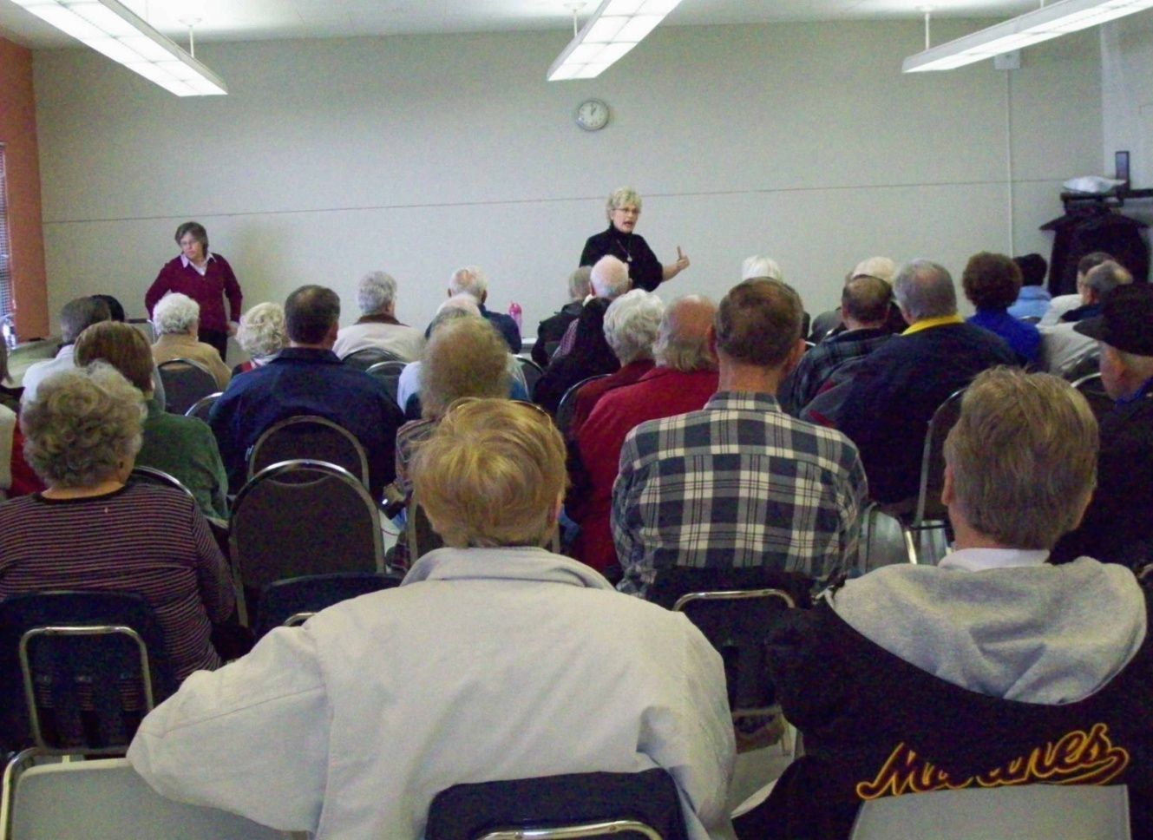
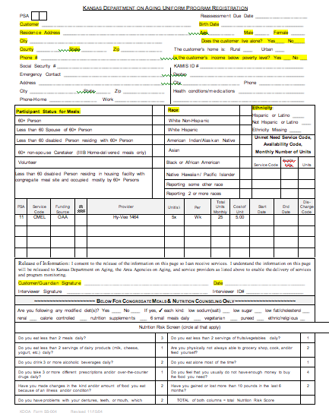
Step 1
Attend Enrollment Session
Registration Form
Notes:
At the enrollment sessions I explain how the program works and how it benefits them. I also speak to them about the senior lunch program at the 8 neighborhood centers and encourage them to take a menu.
Answer questions…slip in a little nutrition education regarding portion control, healthy choices, etc
Required paperwork is completed at this time, donations are made and card is issued

Slide 24
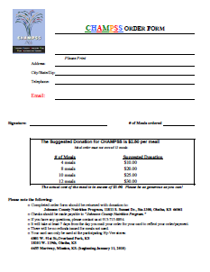
CHAMPSS Order Form
Participant Information
Choose number of meals
Donation is calculated
Notes:
This is the CHAMPSS order form which we have changed several times since implementing the program. We use to list the months with maximum number of meals a participant could order. We quickly determined that individuals weren’t ordering great numbers of meals so we deleted that information. Participants generally order 10 meals at a time. We do suggest a $2.50 donation. There is a chart with the suggested donations based on # of meals ordered. We are averaging $2.50 donation for meals ordered..

Slide 25

CHAMPSS Swipe Card
Magnetic swipe cards are issued to participants with number of meals ordered.
Notes:
Then the seniors receive this magnetic swipe card which looks similar to a debit card.
Each card has a 16 digit number on the back for program identification.

Slide 26
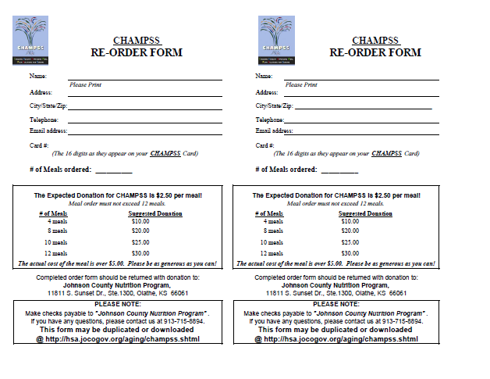
CHAMPSS Re-order Form
Notes:
We do supply reorder forms and preaddressed envelopes in the beginning with postage and now without. These envelopes have CHAMPSS stamped on them for easy identification

Slide 27

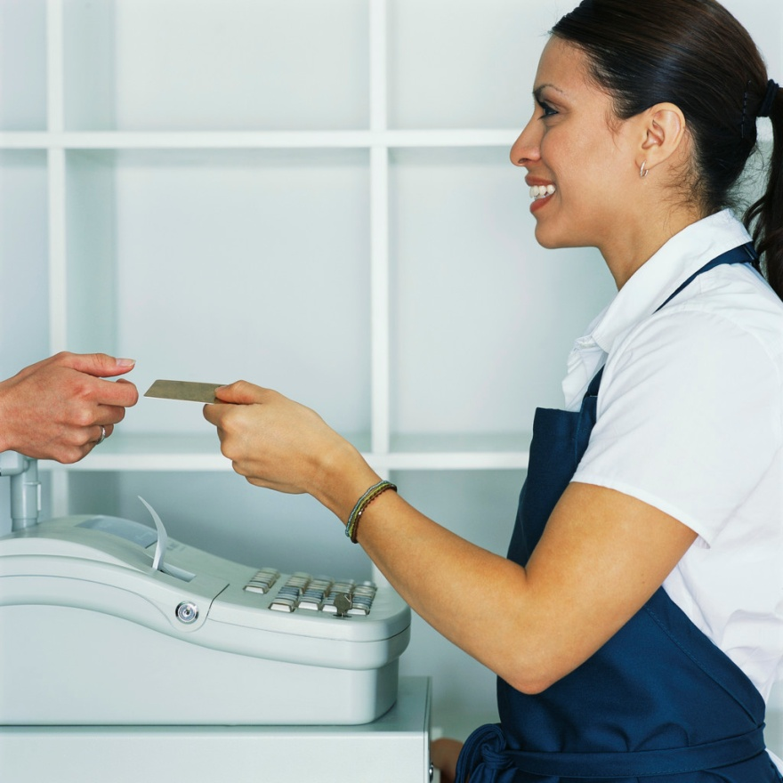


Credit Card Option

Slide 28
Step 2
Select Menu Choices
CHAMPSS participant shows
Hy-Vee staff their swipe
card.
CHAMPSS diner chooses
from the Hy-Vee dietitian
approved menu.
Notes:
So now the diner has a card…what do they do? They go to the specified Hy-Vee and show their CHAMPSS card to the food server in the dining area of the grocery store. The individual then selects their food . The choices are designated by the CHAMPSS approved logo

Slide 29
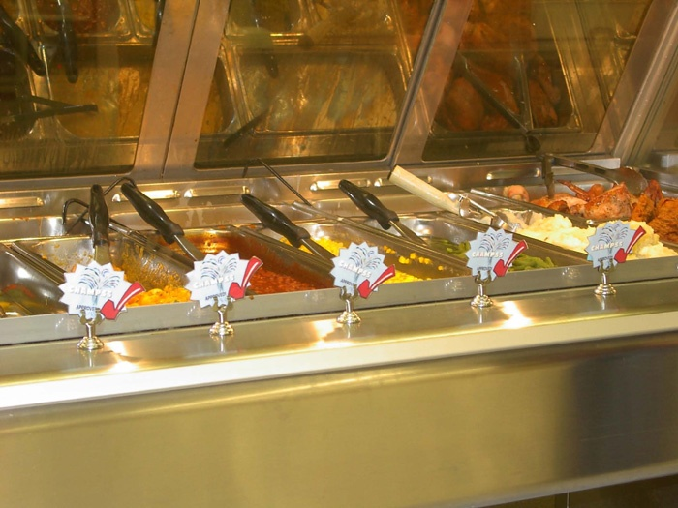
CHAMPSS
Hot Food Choices
Notes:
This is the hot food area of one of our 3 locations. You can see the CHAMPSS logo is displayed by the approved items so the participants know which foods to choose from.

Slide 30

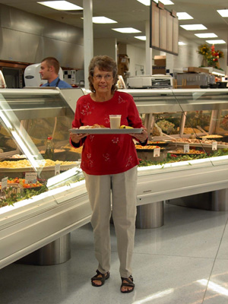
1ST CHAMPSS Participant
Notes:
Our first CHAMPSS participant with her meal tray…after receiving her meal is walking to the pay station to swipe her card before eating. Kansas allows both dine in and carry out, so actually, the first choice a senior must make is whether they want is where they want to eat their meal.

Slide 31
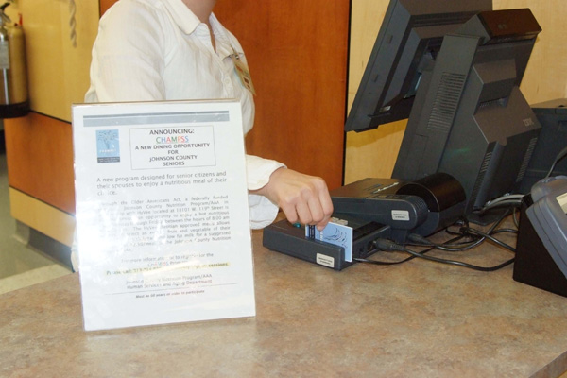
Step 3
Meal Debit
After selecting their items the CHAMPSS card is swiped.
Diner is given a receipt with number of meals left on CHAMPSS card.
Notes:
After the senior has selected all the components of the meal their card is swiped by the cashier. On the counter you can see the receipt printer and POS (Point of Sale) machine. We purchased the hardware from SeniorDine software for $100/each. We supply the receipt tape which cost about $2 per roll.

Slide 32
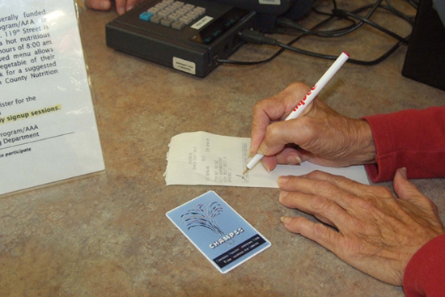
Transaction Complete!
Notes:
Meal authorization occurs automatically via a phone line. Once meal authorization is granted a two part receipt prints which lists the date, time of transaction, participants 16 digit account number, and number of credits left (meals). The participants signs the receipt. Hy-Vee keeps the white copy and the participant keeps the yellow copy.

Slide 33
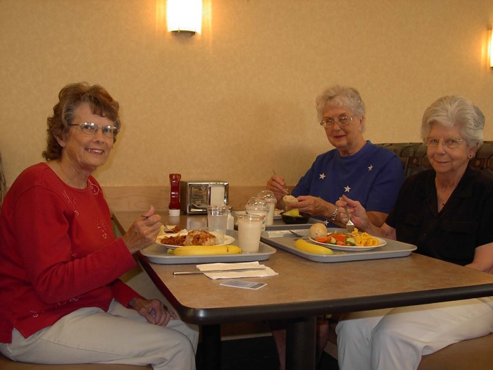
Dining with Friends
Notes:
Here’s a group of participants eating lunch. Many of the participants do come with their friends. Various breakfast and lunch groups have been formed. Several have set up carpools which benefits those that don’t drive.

Slide 34
Summary:
How CHAMPSS Works
Step 1 – Attend an enrollment session, register and complete the order form.
Step 2 – Select from menu choices.
Step 3 – Use the swipe card for meal payment.
Enjoy dining!

Slide 35
Comparison of Traditional &
Non-traditional Meal Programs
 | Traditional | Non-Traditional
Hours per day | 3 hrs | 11 hrs
Days per week | 5 days | 7 days
Meals | Lunch | Breakfast, Lunch, Dinner
Choice | 2 entrée options | 4 options per food group
Seating | Limited | Unlimited
Facility | Multi-use room | Dedicated dining area
Attitude | “Only seniors eat there” | “People of all ages eat there”

Slide 36
How We Created & Implemented
CHAMPSS
Getting Started
Timeline and Steps
Agreements & Partnerships
Program Management

Slide 37
Getting Started - Research
CONGREGATE
SURVEY
Interested in alternative dining option
VOUCHER PROGRAMS
Catholic Charities, Waukegan, Ill
Catholic Charities of Fairfield County, Stamford CT
Senior Nutrition Services, Waterbury CT
Elderly Nutrition Program, Torrington, CT
MEAL TRACKING OPTIONS
Manual entries made by nutrition staff
CatMatt Software Solutions, Windham, New Hampshire,
John Sansoucie
MJM INNOVATIONS –SAMSCAN SWIPE
47% - yes
Notes:
So where did we start? After hearing about restaurant voucher programs at a MOW’s conference 2006, Nancy Tanquary, Nutrition Manager and myself with the assistance of dietitian interns began researching these programs. First we contacted those that were already doing a voucher program. We found 3 programs that are offering restaurant voucher programs in small communities that didn’t have a nutrition program. The 4th program that we spoke with was no longer providing the service due to funding. We set up a telephone conference call with each provider and sent them questions ahead of time so they could gather information if needed. We asked about their process, their success, their concerns, their method of meal tracking, their donations. Anything we thought of we asked and they were more than helpful…several times over. We set questions and sent and ask all the same questions so we could compare the programs. They sent us their agreements.
We also received referrals for software programs that we were able to teleconference with deciding on the best for our program.
Surveyed the seniors

Slide 38
Timeline & Steps
Research – 18 Months
Established Goals for non-traditional program
Area Plan – APPROVED
Grocery Store Selected
Discussions with HY VEE Dietitian
Planning Meetings with Store Director
Agreement/Contract Completed
Implementation

Slide 39

“Scope of Service”
Today’s HY VEE Agreement
Provide nutritional meals between 8:00 a.m. to 7:00 p.m. seven days a week.
Provide meals that will consist of
1/3 Recommended Daily Allowance:
              3 ounces meat/protein
              2 servings (1/2 cup of fruit and vegetable)
              8 ounces 1% milk (packaged in carton)
              2 servings bread/grain
Notes:
When we approached Hy-Vee with the idea, they were extremely receptive. We had an agreement which outlined how the program would work and who was responsible for what. From the very first meeting, they said they would be interested so we were thrilled.

Slide 40
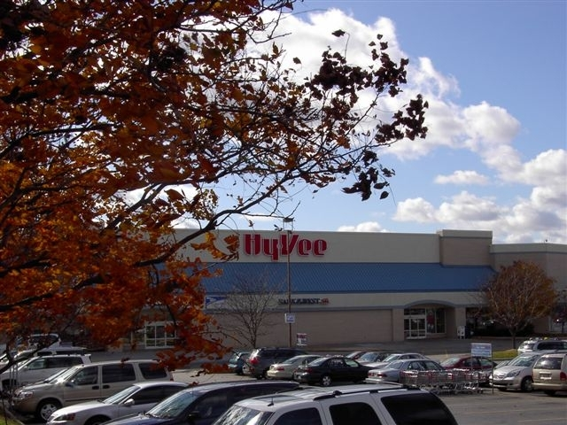
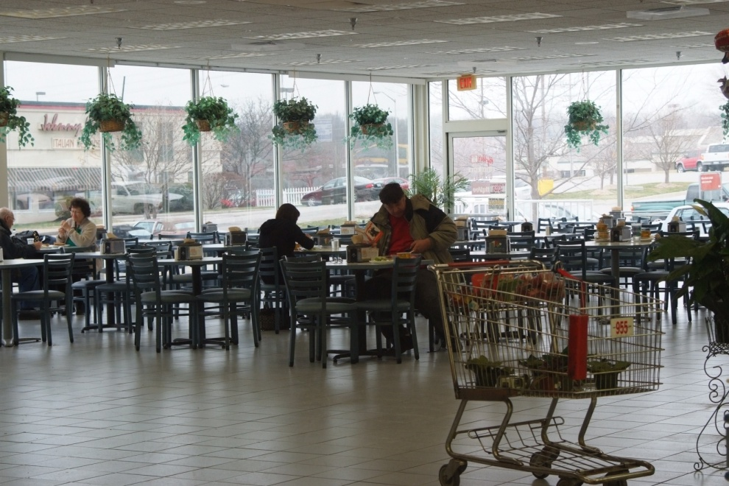
2nd CHAMPSS
January 4, 2009
Notes:
January, 2009, we expanded to another area of the county that has a heavy population of seniors. This store quickly doubled our numbers of participants and has passed the number meals served each month over the other location.
Dining area of second store…offers bingo every Tues morning from 9:00-11:00. When we launched the program in this area we made a brief presentation about the program during a bingo break, offering to be back the next week for those that wanted to enroll in the program. Now we have Bingo players eating CHAMPSS breakfast while other Bingo players eat lunch after playing.

Slide 41
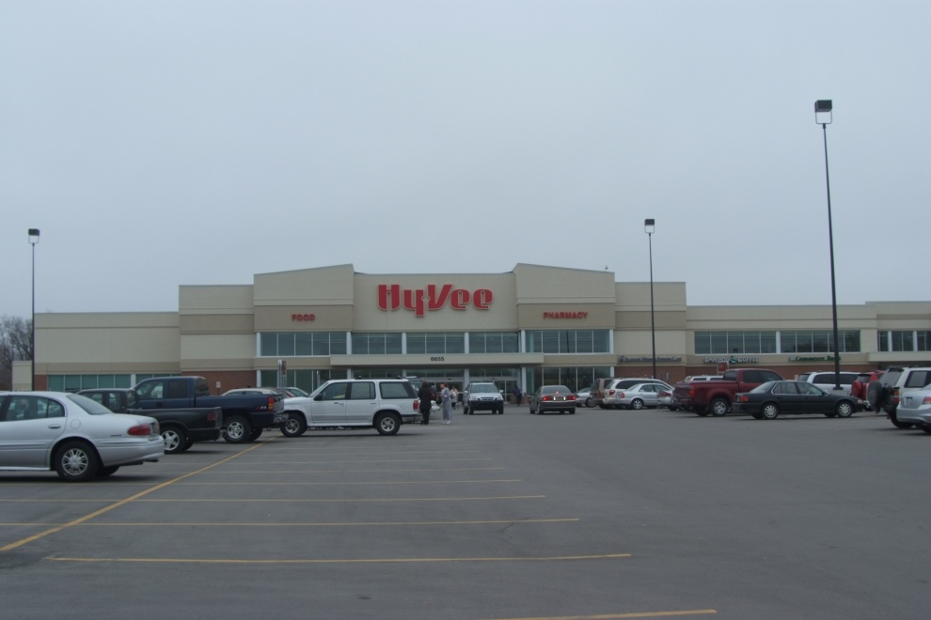
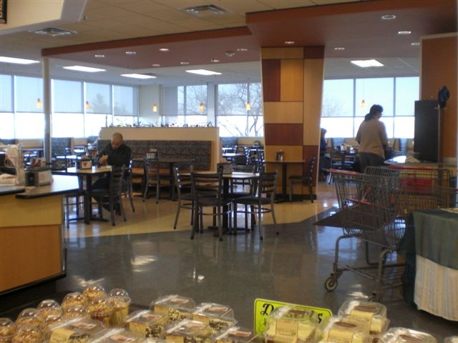
3rd CHAMPSS
January 11, 2010
Notes:
January 11, was the launch date of our 3rd site. All 3 stores are located in heavily senior populated areas. This store recently completed a complete makeover so it was as if we were starting in a brand new store.

Slide 42
How it Works:
Program Management
SAMS
Social Assistance Management System (DATABASE)
SeniorDine
CatMatt Software Solutions
KAMIS
Kansas Aging Management Information System
Notes:
We follow all of the same procedures for CHAMPSS as we do for the 8 traditional meal sites. When a new participant eats at a nutrition site, they must complete the Kansas UPR just like CHAMPSS. All participants information is entered into the SAMS data base
SAMS – the dept. internal management system for tracking participants. With this program we are able to track when annual reassessment forms are due as well as tracking the number of participants at each center.
Senior Dine is the web based program that we use for meal tracking, meals are credits in the program and that’s how we track meals and times of when they ate. Tracks by id number not name. We pay according to the meal count rec. from SD. We match Hy Vee invoice to the monthly meal report . Terrific to work with…patient, kind, helpful
KAMIS- the state requires us to enter our monthly meal numbers per individual.

Slide 43
SeniorDine
A web based nutrition management program that provides the following services:
  Assigns participant swipe card
  Loads number of meals on card
  Maintains meal history
  www.seniordine.com
Notes:
We use a web based software program called SeniorDine Restaurant by CatMatt software solutions. They are located in Windham, New Hampshire.
We assign a 16 digit card number to each individual on the website and load the number of meals ordered. We pay a monthly fee of $9.95 for 100 swipes. It costs .10 for each additional swipe. This monthly fee gives unlimited access to the web, the ability to download, offload and import data daily.
We purchase swipe cards in lots of 100. It costs .90 cents/per card with color front and black text on the back. You can get black and white that costs .52/card or photo id’s for $1.79/card.

Slide 44
CHAMPSS Program Expenses
SET-UP COSTS
CatMatt Software Solution, LLC
Tranz 380 Terminal $100.00
Tranz P250 Printer 100.00
400 CHAMPSS Cards 388.00
Phone and Voicemail 407.75
Miscellaneous Expenses 500.00
TOTAL: $1495.75

Slide 45
Monthly Expenses
1st Six Months of Operation
$5.00 per meal– HY VEE $11,035.00
$10.00 per month first 100
meal debits - Senior Dine 60.00
$.10 per additional meal debit
Senior Dine 219.60
Total = $11,314.60

Slide 46
What We’ve Learned
Improved Grocery Store Agreement:
  Milk packaging
  Equipment repairs
  Minimum of 4 food choices
  Dedicated – Unblocked telephone line
  needed to allow long distance for swipe card
Limit advertisements
Manage growth to ensure quality
Train and monitor grocery store staff

Slide 47
A Typical Day in the Life of
CHAMPSS
Meal Choices
Special Menus

Slide 48
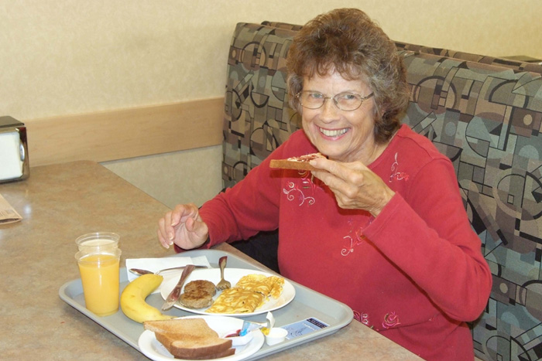
CHAMPSS Breakfast Choices
8-11 a.m.
FRUITS: CHOOSE 2
1 MEDIUM APPLE, ORANGE BANANA, PEAR OR
    3/4 CUP ORANGE OR
    100% FRUIT JUICE OR
`/2 CUP MIXED MELON CHUNKS OR
`/2 CUP CANNED FRUIT OR ` FRUIT COCKTAIL
DAIRY: 1 CUP 1% MILK
(MAY SUBSTITUTE LACTO-FREE OR VIT. D FORTIFIED SOY MILK
GRAINS: 2 SLICES WHEAT TOAST OR
1 CUP OATMEAL OR
1 ENGLISH MUFFIN
MEATS: 2 EGGS, ANY METHOD +
2 TURKEY SAUSAGE LINKS OR
2 TURKEY BACON SLICES
2 EGG OMELETS WITH 1/2 CUP VEGETABLES +
2 TURKEY SAUSAGE Links OR TURKEY BACON SLICES
FRUIT: CHOOSE 2
APPLE, ORANGE, BANANA, PEAR OR ¾ CUP ORANGE JUICE OR
FRUIT JUICE
DAIRY: 1 CUP 1% MILK OR SOY MILK
DAIRY: 1 CUP 1% MILK
Notes:
This is the breakfast menu which is served 8 am. to 11 am. The participants choose items from these food groups . The grain group has 2 slices of wheat bread, 1 cup of oatmeal, or English muffin. For meat, they can have 2 eggs prepared any method with turkey sausage or bacon. Many participants order a 2 egg omelet with ½ cup of vegetable. They choose 2 fruits which is either pieces of fruit, 100% fruit juice, or ½ cup mixed melon cup. Dairy is 1%milk or soy milk.

Slide 49
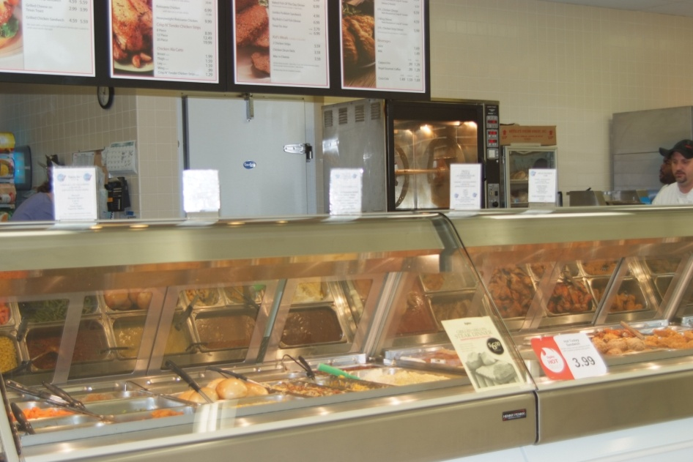

CHAMPSS Lunch & Dinner Choices
MEAT ENTRÉE = 3 OZ
CHOOSE 1 OF FOLLOWING
CHAMPSS
APPROVED SELECTIONS
BAKED CHICKEN
ROASTED TURKEY
ROAST BEEF
MEATLOAF
BAKED PORK LOIN
PULLED PORK
FISH ENTRÉE = 5 OZ
SALMON
TILAPIA
GRAINS =
1 SMALL DINNER ROLL +
1/2 CUP OF FOLLOWING
CHAMPSS
APPROVED SELECTIONS
RICE
MACARONI & CHEESE
PASTA
or
1 HAMBURGER BUN
Notes:
This is the lunch/dinner menu that’s served 11 am – 7 pm. The participants choose items from each of these food groups. For grains they can have 1 dinner roll with brown rice, or macaroni & cheese, or mashed potatoes w/ 2 TBSP of gravy, or hamburger bun. Meat group is 3 oz of cooked meat. Items like tilapia, salmon, & Mediterranean chicken. Vegetables, fruit, and dairy.
We also place signs in the appropriate area so the seniors know what is CHAMPSS approved as well as serving size just as a reminder of portion control. As you can see the variety is great!

Slide 50
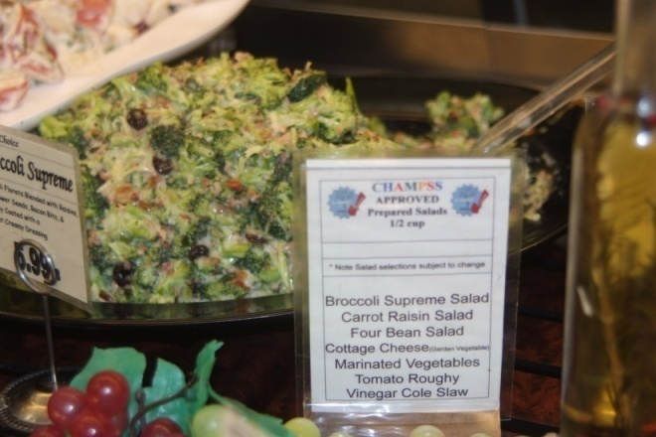
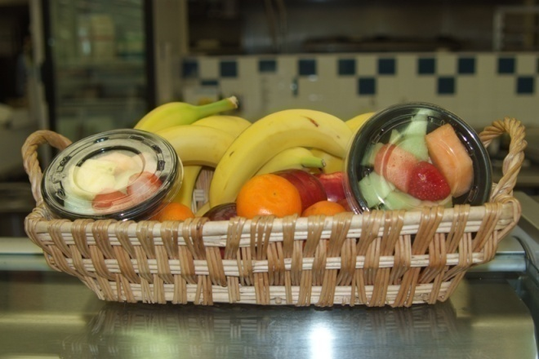
CHAMPSS Lunch & Dinner Choices
VEGETABLE= 1/2 Cup
CHOOSE 1 OF FOLLOWING
CHAMPSS
APPROVED SELECTIONS
Broccoli
Brussels Sprouts
Carrots
Corn
Green Beans
Potatoes – any variety
Vegetable Medley
*Note - Vegetable selections subject to change
FRUIT =
3/4 CUP OR
1 PC WHOLE FRUIT OR
3/4 CUP JUICE
CHOOSE 1 OF FOLLOWING
CHAMPSS
APPROVED SELECTIONS
Apple
Banana
Orange
Pear
Fruit Cocktail
3/4 cup Mixed Melon Chunks
100% Fruit Juice
Note - Fruit selections subject to change
Notes:
This is the list CHAMPSS approved fruits and vegetable as well. Meals are complete when the seniors receive their milk which is either 1% or soy milk and a whole wheat dinner roll.

Slide 51
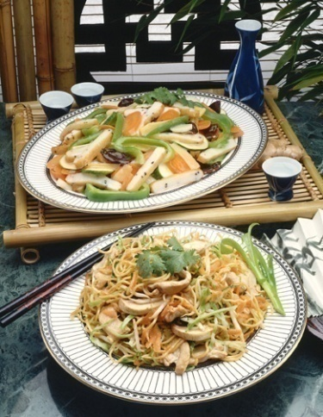
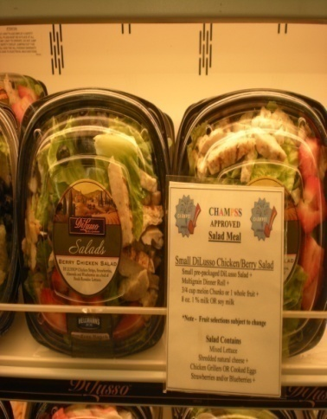
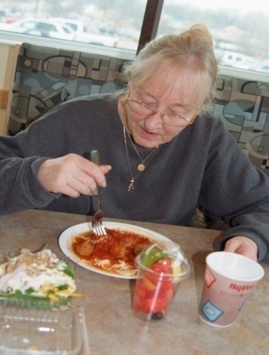
CHAMPSS
Special Menus
Spaghetti and Meatballs Meal
1 cup cooked pasta
1/2 cup marinara sauce
3 - 1 oz meatballs
1 CHAMPSS side salad
3/4 cup assorted melon chunks
8 oz. 1% milk or soy milk
Pizza Meal
2 slices (thin crusts only)
plain cheese or veggie topped pizza
1 CHAMPSS side salad (described above)
3/4 cup assorted melon chunks
8 oz. 1 % milk or soy milk
Small DiLusso Chicken/Berry Salad
Small pre-packaged DiLusso Salad +
Multigrain Dinner Roll +
3/4 cup melon Chunks or 1 whole fruit +
8 oz. 1 % milk OR soy milk
*Note - Fruit selections subject to change
Chinese Meals
1 cup of any approved entrée below +
1 cup of steamed rice +
Fortune cookie +
3/4 cup melon chunks or 1 whole fruit
8 oz - 1% milk or soy milk
Notes:
We also offer 3 specialty menus which include Chinese, Italian and a prepackaged dinner salad complete with chicken. This is the Italian choices…spaghetti and meatballs meal or pizza meal.

Slide 52
Marketing & Communications
CHAMPSS

Slide 53
Marketing Strategies
Presentations
Senior Quest
WORD OF MOUTH
Area Agency on Aging
Notes:
We were told by our research questions that there was no need for marketing. How true….however in the beginning we had to get the word out somehow. So, based on the congregate surveys we went to the nutrition sites first…presentations were made

Slide 54
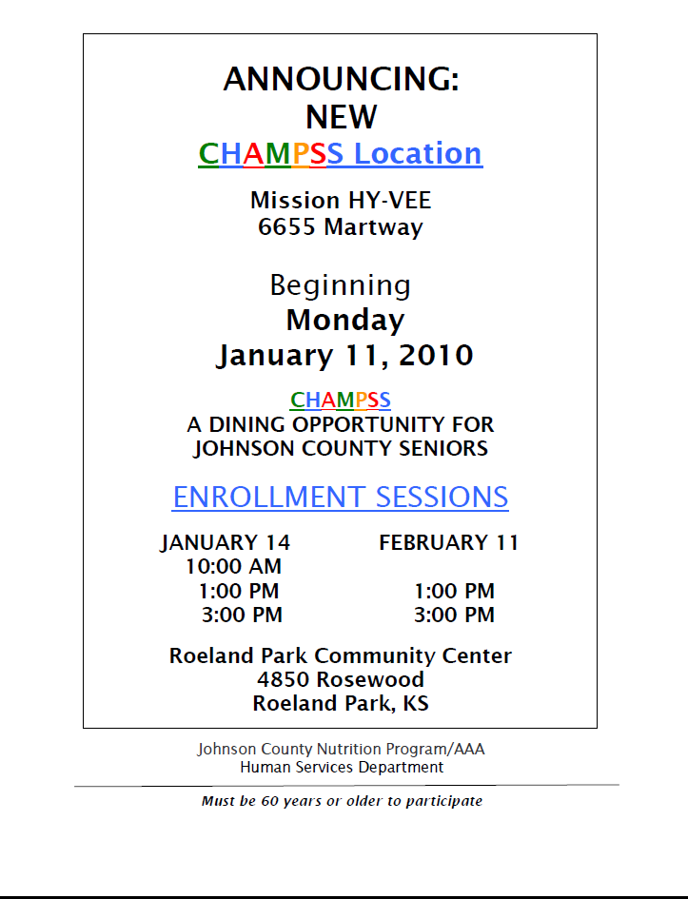
Enrollment Announcement
Notes:
We were told by our research questions that there was no need for marketing. How true….however in the beginning we had to get the word out somehow. So, based on the congregate surveys we went to the nutrition sites first…presentations were made

Slide 55

Senior Quest
Notes:
SQ is information fair for older adults. We had a booth the first year when we only had the one location. Shortly after this fair we were able to announce the second location. This format was another way to get the word out in other areas of the county. Needless to say, by the second year we didn’t need to have a booth as communication and marketing of the program was developing on it’s own.

Slide 56
Accessing CHAMPSS
Information
Enrollment information and reorder forms are available at HyVee
CHAMPSS Newsletter http://hsa.jocogov.org/documents/CHAMPSSNewsletterSpring2012.pdf
Best Times Newspaper http://hsa.jocogov.org/aging/articles/aaa_champss_announcement.shtml
Website http://hsa.jocogov.org
Notes:
So ….. how do potential participants get information packets regarding the CHAMPSS program. Three ways. There are packets of information at Hy-Vee by the register, they can call our dedicated CHAMPSS phone line to request information, or they can access the information via our website. We have just recently had information available via the website which we feel will be extremely beneficial.

Slide 57
Measuring Results

Slide 58
Survey Results
I feel my health has improved since I began eating CHAMPSS meals.

Slide 59
Survey Results
It is easy to re-load my card with meals.
Notes:
We now have two ways seniors can reload their cards. As stated earlier they can use the reorder forms. Complete the information and mail along with their donation back to us or now, they can call the CHAMPSS line and add meals to their account using their credit card.

Slide 60
Survey Results
I also attend a Senior Nutrition Center for lunch.
Notes:
We now have two ways seniors can reload their cards. As stated earlier they can use the reorder forms. Complete the information and mail along with their donation back to us or now, they can call the CHAMPSS line and add meals to their account using their credit card.

Slide 61
Awards and Recognition

Slide 62

Awards and Recognitions
National Association of Nutrition and Aging Services Programs
STAR AWARD
The National Association of Area Agencies on Aging
ACHIEVEMENT AWARD

Slide 63
Awards
National Association of Counties ACHIEVEMENT AWARD
American Dietetic Association Healthy Aging Practice Group
BEST PRACTICE AWARD
National Meals on Wheels
BEST PRACTICE RECOGNITION

Slide 64
Today’s Statistics
3 Grocery Store Partners
2000 Active Participants
100 Meals Served Daily
700 Meals Served Per Week
Average Donation - $2.50
Notes:
To date, we have more than 1500 active participants enrolled in the CHAMPSS program. Feb. was the first month to track meals for an entire month of 7 days per week. The ave 80 participants served in Feb. for 7 days per week/ 28 days in the month.

Slide 65
Summary
Today’s topics include:
  Who we are
    (county, agency, nutrition program)
  Our traditional meal program
  The new system – what we thought would work
  The new system – what really works and why
  How we did it
    (research, contacts, contracts, costs, partners and resources)
  Marketing the program
  Measuring the results
  Awards and recognition

Slide 66
C
H
A
M
P
S
S
Choosing Healthy Appetizing Meal Plan Solutions for Seniors
Thank You!
Notes:
I’m delighted to be here and excited to tell you about our CHAMPSS program which we implemented in 2008.This is a work in progress which began in 2006 and we continue to change and tweak as we go along. So my disclaimer here is that we don’t have all the answers but hopefully I can guide and a point of reference to start with.

