Slide 1
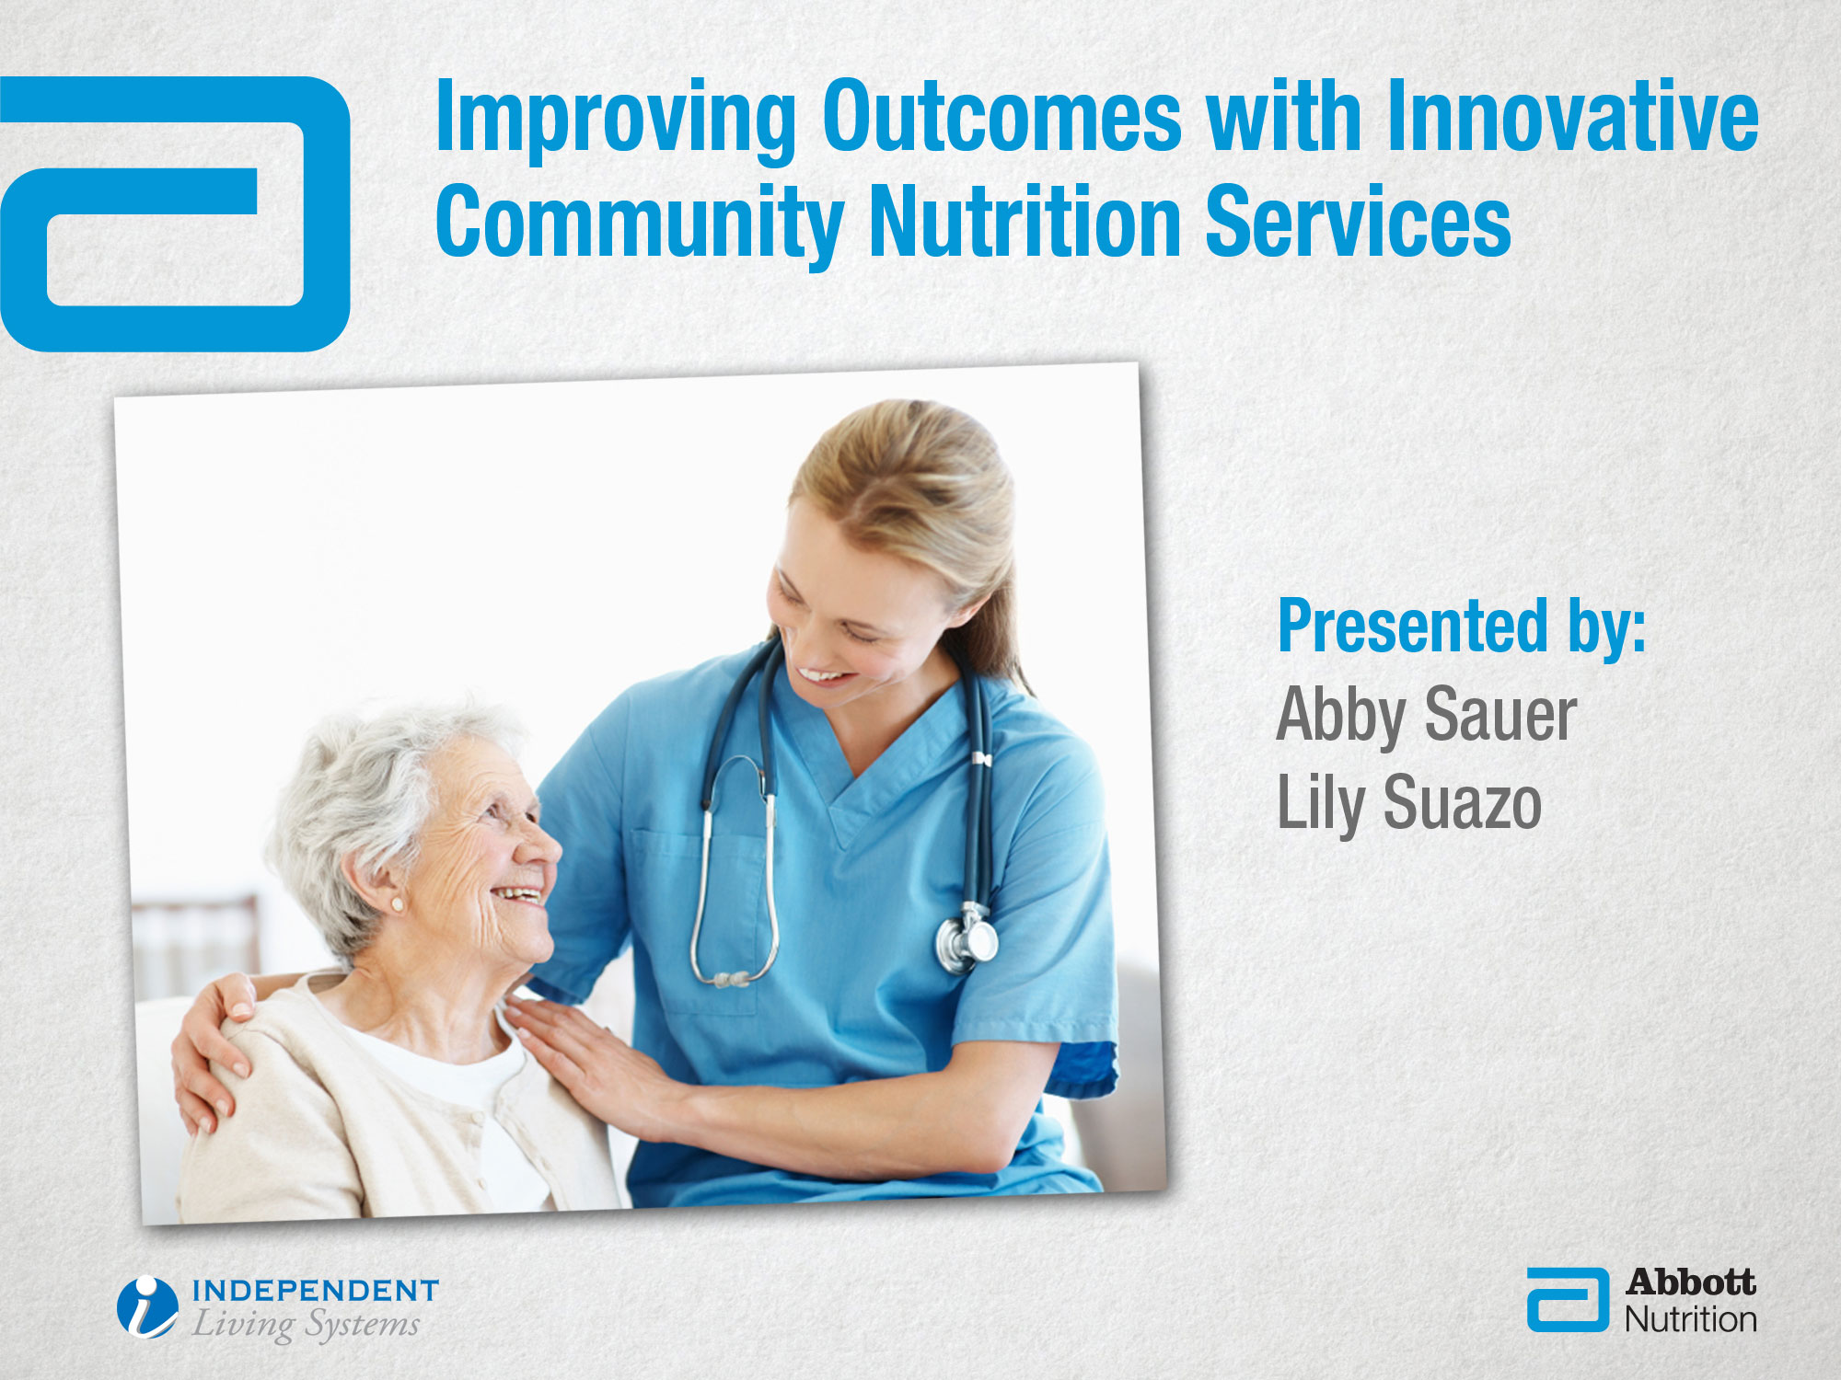

Slide 2
Speakers
Abby Sauer Abbott Nutrition Research Scientist MPH, RD, LD
Lily Suazo ILS Wellness and Nutrition Manager RD, LD/N

Slide 3

Learning objectives
Highlight nutritional issues in older adults living at home
Understand the connection between nutrition intervention and outcomes
Discuss community-based care transitions and explain a new approach to improve outcomes and reduce cost of care

Slide 4

Nutritional Issues in Community-dwelling
Older Adults and the Impact of Nutrition Intervention

Slide 5
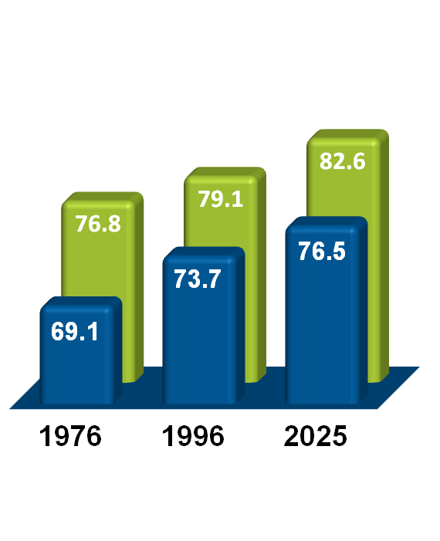
Americans are aging and living longer
US Population, Adults 55+ (MM)
Average Life Expectancy in the US (Years)
2030
112
2020
98
2010
77
Women
Men
Everyday, for the next 18 years, 8,000 “baby boomers” will be turning 65¹.
By 2010, overall life expectancy in the US increased to ~79 years¹.
CDC 2010 preliminary data _040912 http://www.aarp.org/personal-growth/transitions/boomers_65/

Slide 6
Older patients suffer from one or more chronic diseases
33
Hypertension
28
23
Disease
Prevalence
Among
Age 55+ (%)
Sarcopenia
(Loss of lean body mass)
18
13
Diabetes
Osteoporosis
Heart Disease
8
COPD
Alzheimer’s
Cancer
3
2011
2015
2020
2025
US Census Bureau. December 2009; Timely Data Resources, Inc. Disease incidence: a prevalence database, December 2009; Iconoculture: Consumer Outlook Health and Wellness 2008-2009.

Slide 7
Malnutrition is caused by the unique characteristics of older adults
Body
Composition
Changes
Cognitive
Impairment
Socioeconomic Status
Multiple
Comorbidities
Malnutrition
Inadequate
Food & Fluid
Intake
Psychosocial
Challenges
Physical
Impairments
Polypharmacy
Fuhrman MP. Nutr Clin Pract 2009; 24:196-205.
Notes:
Malnutrition is multifactorial and can be caused by several different and often contributing factors. This slide highlights just some of the major causes of malnutrition, such as:
Chewing and swallowing difficulty – it is often a challenge for patients with chewing and swallowing difficulties to consume adequate nutrition and fluids.
Chair bound or bed bound status – patients who have limited mobility and who are chair or bed bound often have decreased nutritional requirements but also may have limited oral intake of both nutrients and fluid.
Living alone – patients who live alone and who do not have a strong support system tend to eat limited amounts of food.
Illness and chronic conditions – many illnesses and chronic conditions, such as cancer, COPD, diabetes, and chronic kidney disease can impact a patient’s nutritional status and nutrient intake and therefore lead to undernutrition or malnutrition.
Elderly – as we have discussed, the elderly are at high risk of malnutrition due to several factors including aging, chronic conditions, and decreased nutrient intake and absorption.
Socioeconomic deprivation – patients who have financial constraints may be challenged to eat an adequate food intake.
Living in a home for the elderly – as we have also seen, elderly patients living in long-term care facilities are at high risk for malnutrition.

Slide 8
Key challenges among nutritional intake and access to nutrition exacerbate problem of malnutrition
Inadequate
Food & Fluid
Intake
Physical
Impairments
Socioeconomic Status
93% had at least one problem with eating and digestion
50% required assistance with shopping and food preparation
Soini H, et al. J Gerontol Nurs. 2006;12-17.
Notes:
Finland home care study (n=178)
~50% of clients were malnourished or at nutritional risk
93% had at least one problem with eating and digestion
1/3 had an unbalanced diet
50% required assistance with shopping and food preparation
This study describes the nutritional status of Finnish home care patients (n=178), their problems related to eating, digestion, and diet; their use of Meals on Wheels services; and informal caregivers' role in nutritional support. Half of the patients were at risk for malnutrition and 3% were malnourished according to Mini Nutritional Assessment (MNA) results. Most patients had problems with food intake, which were related to lower MNA scores. One-third of the participants had an unbalanced diet, and approximately half received assistance with shopping and food preparation from an informal caregiver. Home care patients' nutritional status, including all related aspects, such as shopping, food preparation, eating, and digestion, must be evaluated regularly and comprehensively.

Slide 9


Patients who suffer from malnutrition will also have a loss of lean body mass
Lean body mass includes
muscle, skin, bones, and organs
Loss of Lean Body Mass
Aging & Bed rest /
decreased activity
Illness & Injury
(Inflammation)
Demling RH. Eplasty. 2009;9:65-94.
Notes:
KEY TAKEAWAY – “There are 3 drivers for loss of lean body mass: aging/bed rest and illness/injury.”
Refer to the “Know Your Patients” box: “Consider your patients’ pre-admission status. Oftentimes people are ill and in bed for a significant amount of time prior to being hospitalized.”

Slide 10
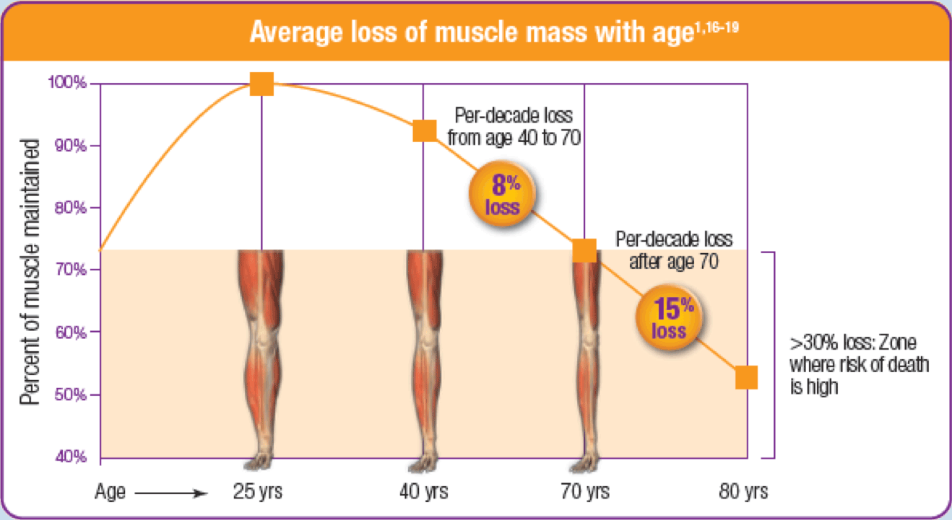
Progressive loss of lean body mass is a natural part of aging
Average loss of muscle mass with age¹⁻⁶
Average loss of lean body mass with aging¹⁻⁶
1. Grimby G, Saltin B. Clin Physiol. 1983;3:209-218; 2. Janssen I. J Appl Physiol. 2000;89:81-88; 3. Grimby GB, et al. Acta Physiol Scand. 1982;115:125-134; 4. Larsson L, et al. J Appl Physiol. 1979;46:451-456; 5. Flakoll P, et al. Nutrition. 2004;20:445-451; 6. Baier S, et al. JPEN J Parenter Enteral Nutr. 2009;33:71-82.
Notes:
After the age of 40, muscle mass decreases by approximately 8% per decade¹⁻⁶
After the age of 70, muscle loss accelerates to approximately 15% per decade¹⁻⁶
Loss of muscle and function with age is known as “Sarcopenia”.
30% of adults over age 60 and 50% of adults over age 80 experience this loss of muscle and function in the United States.
Between the ages of 30 and 40 the decline in mass can begin; between the ages of 40 and 70, there can be an 8% loss of lean mass per decade, and 15% loss per decade after the age of 70 years.
Muscle peaks and declines in a similar fashion as bone. Sarcopenia is as to the muscle as Osteoporosis is to the bone.
It is essential to maintain skeletal muscle over the years as a decline over time coupled with acute loss due to a stress or injury may lead to inability for recovery.
$18.5 billion dollars in direct healthcare costs were attributable to sarcopenia in 2000.

Slide 11



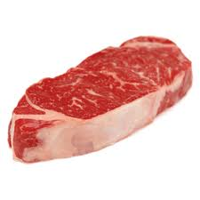
Illness and injury accelerate muscle loss
Healthy Young (36-28 years of age)
28 Days Inactivity¹
Inactivity¹
Healthy Older Adult (67 years of age)
10 Days Inactivity
Elderly Inpatients (Age: 65+)
3 Days Hospitalization³
0
.5
–1.0
Loss of Lean Leg Mass (lb)
Approx 1 lb
–1.5
–2.0
–2.5
Approx 2.2 lbs
Approx 2.2 lbs
2.2 lb steak =
1. Paddon-Jones D, et al. J Clin Endocrinol Metab. 2004;89:4351-4358. 2. Kortebein P, et al. JAMA. 2007;297:1772-1774. 3. Paddon-Jones D. Presented at: 110th Abbott Nutrition Research Conference; June 23-25, 2009; Columbus, Ohio.

Slide 12
Patient’s nutritional status and lean body mass becomes progressively compromised as they travel through the continuum of care
Upon Admission to the Hospital
30% to 50% are malnourished upon admission^{1,2}
During Hospital Stay
37% of patients hospitalized for 1-2 days have lean body mass loss³
Post-discharge
Many patients continue to lose weight after discharge⁴
1. Schiesser M, et al. Surgery. 2009;145(5):519-526. 2. Naber THJ, et al. Am J Clin Nutr. 1997;66:1232-1239. 3. Pichard C, et al. Am J Clin Nutr. 2004;79(4):613-618. 4. Beattie AH, et al. Gut. 2000;46(6):813-818.

Slide 13
Patients are admitted into home health in nutritionally compromised states
Major nutritional issues impacting home health clients:
Condition | % of Home Care Patients
Malnutrition¹ | 13-21%
*Loss of Lean Body Mass² | ~25%
Wounds³ | 44%
51% At Risk⁴
*Statistic is from community-dwelling older adults
Tackling Malnutrition: Oral nutritional supplements as an integrated part of patient and disease management in hospital and in the community. Medical Nutrition International Industry. July 2010.
Iannuzzi-Sucich M et al. J Gerontol A Biol Sci Med Sci 2002; 57: M772-M777.
Johnston P, et al. Remington Report, May 2008; 18-20.
Yang Y et al. J Am Med Dir Assoc 2011; 12: 287-294.

Slide 14

Poor nutrition leads to rehospitalizations as measured by refrigerator content
Objective
Measure outcomes associated with refrigerator contents of elderly patients (nutrition in home)
Population
N = 132 adults aged 65+ who received home visits at least 1 month after hospital discharge
Key Findings
Elderly people were more frequently readmitted (P = 0.032) and admitted 3 times sooner (34 vs. 100 days); (P = 0.002) compared to those who did not have an empty refrigerator
Boumendjel N et al. Lancet 2000; 356: 563.
Notes:
132 patients aged over 65 years had a thorough assessment of their refrigerator contents and the numbers and dates of admission were recorded. Elderly people with empty refrigerators were more frequently admitted (p=0·032) in the month after assessment and three times sooner than those who did not have empty refrigerators (34 vs 100 days, p=0·002).

Slide 15
Patients "at risk" are more likely to experience emergent care visits and rehospitalizations
Objective
To identify the association between baseline nutritional status and subsequent health service utilization and mortality
Population
N = 198 older adults receiving Medicare home health services for 1 year
Key Findings
12% were malnourished and 51% were at risk
Those who were malnourished or at risk at initial assessment were more likely to experience (6 months, 1 year):
Subsequent Hospitalization (P=.040)
Number of Hospital Admissions (P=.045)
ER Visit (P=.047)
Mortality (6 months, P=.001; 1 year, P=.031)
Yang Y et al. J Am Med Dir Assoc 2011; 12: 287-294.

Slide 16

Loss of lean body mass loss leads to difficulty performing ADLs
Loss of lean body mass
Loss of strength
Difficulties performing activities of Daily Living (ADLs)
Eating
Transferring
Toileting
Ambulating
Eating
Transferring
Toileting
Ambulating
1 Demling RH. Eplasty. 2009;9:65-94. 2 Paddon-Jones D, Sheffield-Moore M, Cree MG, et al. J Clin Endocrino Metab. 2006;91:4836-4841. 3 Paddon-Jones D. In: Gussler J, ed. The Role of Nutrition in Accretion, Retention, and Recovery of Lean Body Mass. Report of the 110th Abbott Nutrition Research Conference: Selected Summaries. Columbus, Ohio: Abbott Nutrition; 2009:9-14. 4 Engelen MP, Schols AM, Baken WC, et al. Eur Respir J. 1994;7:1793-1797. 5 Evans WJ, Morley JE, Argilés J, et al. Clin Nutr. 2008;27:793-799.
Notes:
KEY TAKEAWAY – To put in perspective, express how lean body mass affects the simplest of functions, such as getting up from a chair, and other everyday activities (ADLs).
This is a good opportunity to evoke emotion and encourage thinking by your participants.
QUESTION – “Imagine how your patients might feel if they could not perform their everyday activities due to loss of strength.”
Slide 8: ADL
Because loss of muscle or functional tissue leads to loss of strength – balance and ultimately difficulty performing activities of daily living such as walking, toileting and even eating.

Slide 17
Malnutrition and loss of lean body mass can seriously impact patients’ outcomes
% of Loss of Total Lean Body Mass
Associated Complications
10% Loss
Impaired Immunity (Infections)
20% Loss
Decreased Healing
30% Loss
Wounds
If lean body mass loss reaches 40%,
your patients are at risk of death –
usually from pneumonia
Demling RH. Eplasty. 2009;9:65-94.

Slide 18


Poor nutrition in adults managing a chronic condition leads to exorbitant healthcare costs
2009 Adult ReHospitalizations
2009 Healthcare Costs⁵
2.3MM
$17B
Malnourished patients are significantly more likely
than well-nourished patients to experience rehospitalizations.¹⁻⁴
1. ”Tackling Malnutrition: Oral Nutritional Supplements as an integrated part of patient and disease management in hospital and the community. A summary of the evidence base.” Medical Nutrition International Industry, July 2010. 2. Mudge A, et al. J Hosp Med. 2011;6:61-67. 3. Friedmann J, et al. Am J Clin Nutr. 1997; 65:1714-1720. 4. Vecchiarino P, et al. Heart Lung. 2004;33:301-307. 5 Jencks SF, et al. NEJM. 2009; 360(14): 1418-1428.

Slide 19

Early nutrition intervention with oral nutritional supplements (ONS) has been clinically shown to help you achieve your goals
Patients
Healthcare Providers
Increased wound healing
Decreased complications
Increased recovery
Reduced chronic disease complications
Decreased hospitalizations
Decreased treatment length
Increased Quality
Decreased Cost
1. Collins, CE et al. Nutr. 2005;21:147-155.; 2. Milne AC, et al. Cochrane Database Syst Rev. 2005;(2)CD003288. 3. Stratton RJ et al. Disease-related malnutrition: an evidence based approach to treatment. Wallingford; CABI Publishing :2003. 4. Botella-Carretero, J et al. Clin Nutr. 2010;29:574-579. 5. Norman K et al. Clin Nutr. 2008;27(1):48-56. 6. Volkert D et al. Clin Nutr. 2006;25:330-360.
Notes:
KEY TAKEAWAY – “There are 2 drivers for loss of lean body mass: aging/bed rest and illness/injury.”
Refer to the “Know Your Patients” box: “Consider your patients’ pre-admission status. Oftentimes people are ill and in bed for a significant amount of time prior to being hospitalized.”

Slide 20



You can do this too by implementing simple FIND, FEED, FOLLOW in your agency to improve outcomes
Identify at-risk
clients
Incorporate nutrition intervention into care
Drive patient self-management through education
Notes:
Find previous areas in deck where find, feed follow – bold them?

Slide 21
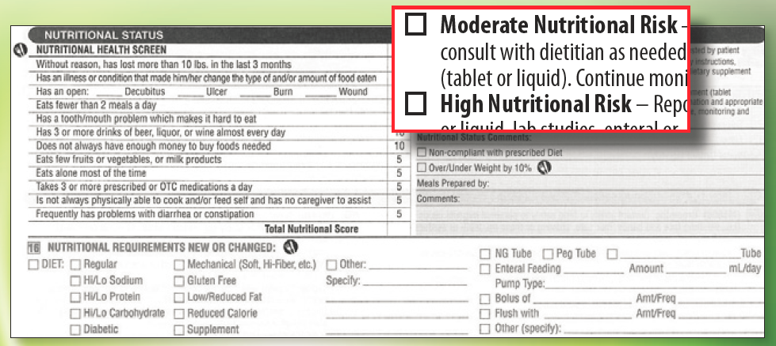
FIND clients at risk
Identify patients at risk through your start of care (SOC) assessment
OASIS

Slide 22



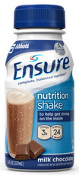
FEED your at risk patients oral nutritional supplements as part of your nutrition interventions
Education
Dietary Counseling
Food
Oral nutritional supplementation
Nutrition
Notes:
Take Action
Build awareness of the importance of nutrition through staff education and training
For all clinicians and skilled staff
Connect with social worker on available resources (i.e.. ONS qualification food stamp program)
Collaborate with partners
Acute care providers
Physician groups
Other referral sources
Outside vendors/external partners
Implement nutrition screening and intervention
Enhance care plans
Develop an early screen and intervene program

Slide 23
FOLLOW client progress and create self-management programs
“Increasing evidence shows that self-management support reduces hospitalizations, emergency department use, and overall costs.”
Educate
Recommend
Reinforce
Coleman and Newton. Supporting self-management in patients with chronic illness. Am Fam Physician 2005;72(8):1503-10

Slide 24

Transition of care is becoming increasingly important in driving improved patient outcomes
Discharge
Transition
Is now going to
Hospitals must pay much more attention to the transition of patient care into post acute / community
Transition of care has not historically been their responsibility
Increased attention on follow-up care
Greater opportunity for active involvement of home health care
Denniston L. New Final HHS Rules on Readmissions. http://connect.curaspan.com/articles/new-final-hhs-rules-readmissions. Accessed October 18, 2011.
http://www.gpo.gov/fdsys/pkg/FR-2011-08-18/html/2011-19719.htm

Slide 25

Success with formal nutrition program has also been demonstrated to improve outcomes
Profile
Bayada Nurses provide nursing, rehabilitative, therapeutic, hospice, and personal home health services
Employs more than 14,000 nurses, home health aides, therapists, and social workers
The Situation
76% of rehospitalizations were identified as preventable
Malnutrition can impact patient outcomes and cause more rehospitalizations
Identified opportunity to elevate role of nutrition in standard of care
Notes:
KEY TAKEAWAY: Bayada recognized a need for nutrition intervention to improve patient outcomes, and partnered with Abbott Nutrition to implement a nutrition screen and intervene program – Feed/Find/Follow
SPEAKER’S NOTES:
Bayada Nurses provides nursing, rehabilitative, therapeutic, hospice, and personal home healthcare to children, adults, and seniors.
Bayada recognized that hospitalizations are a major concern for the older American population.
Many patients who are malnourished in the hospital also experience further nutrition deterioration during their stay, which results in these patients being at high nutrition risk upon discharge from hospital and admission into home health
Bayada recognized that nutrition assessment and intervention is key component of quality care
The stated objectives for this partnership were to:
Improve patients’ outcomes by improving the nutrition status of their home health clients
Educate clinicians on the value of early nutrition screening and intervention to improve transitional care
Eliminate common barriers in the use of oral nutrition supplements
PROBING QUESTION:
How do these objectives relate to your agencies?
What other objectives do your agencies have that we haven’t yet discussed?
TRANSITION:
I’d now like to show you what they did to meet these objectives

Slide 26
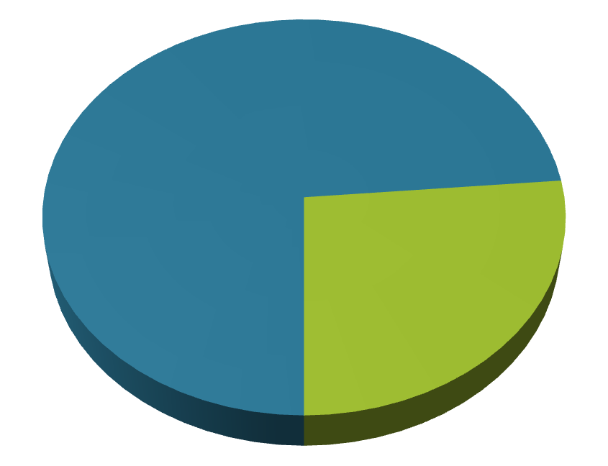
A nutrition FIND, FEED, FOLLOW program was implemented in seven offices throughout the US
Trained clinicians
Completed a nutrition screen at the initial patient assessment
Applied appropriate intervention for “at-risk” patients
Educated patients and caregivers on importance of adherence
Nutrition Pilot: 1,259 Patients Screened
26.4%
332 Patients Identified as at
Nutritional Risk
Notes:
KEY TAKEAWAY: Bayada Nurses implemented nutrition screen and intervene as a six-month program in seven of their offices
SPEAKER’S NOTES:
Bayada implemented our Find/Feed/Follow program that’s at the core of our Feed the 485 Initiative
The steps Bayada specifically followed are these:
1. Completed a nutrition screen at initial assessment
2. Trained clinicians on the appropriate intervention for “at-risk” patients
3. Educated patients and caregivers on importance of adherence
The specific statistics:
1,259 patients were screened
26.4% (332 patients) of those patients in the case study were found to be at moderate to high nutritional risk
76.8% (312 patients) received nutrition education
58.7% (259 patients) received free ONS samples
24.6% (75 patients) purchased additional ONS and continued their nutrition intervention as part of their disease self-management
PROBING QUESTION:
How do you think a similar screen and intervene program would help improve patient outcomes in your agencies?
TRANSITION:
Now let’s take a look at the results.

Slide 27
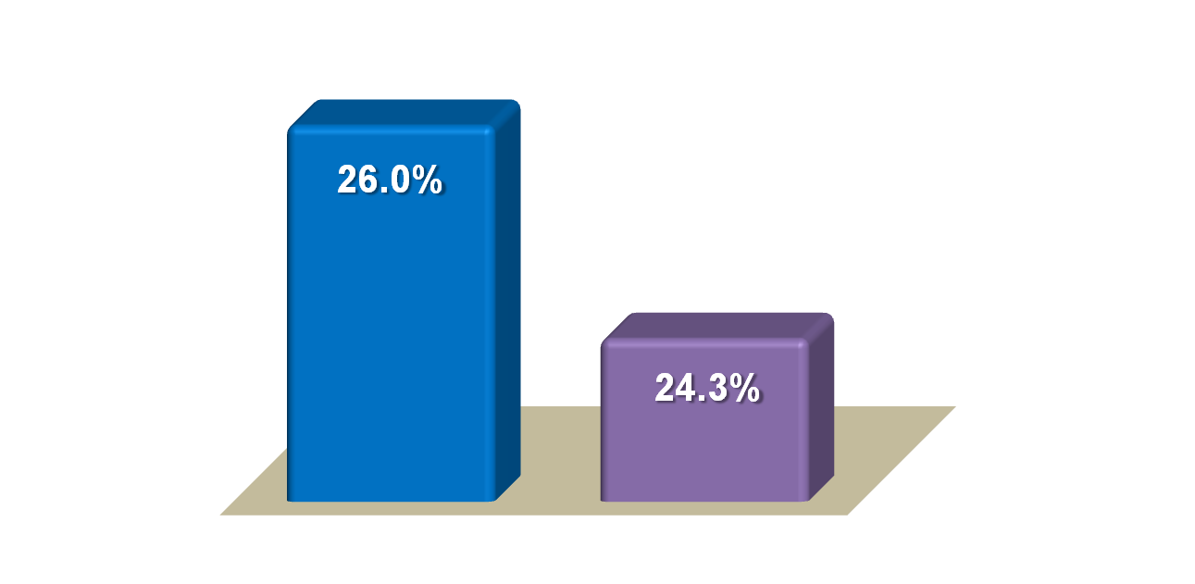
The pilot program showed a trend toward reduced hospitalizations with nutrition intervention
All-Cause Hospitalization Rate
National Average†
Bayada Average*
†medicare.gov/homehealthcompare/search.aspx (data as of 10/11)
*For 7 participating locations
Notes:
KEY TAKEAWAY: Bayada Nurses achieved significant reduction in hospitalizations with nutrition therapy
SPEAKER’S NOTES:
In the 7 offices that participated in the case study only 8.7% of patients at nutritional risk were hospitalized in the 6 month testing period
This is such an important finding because the average rate of hospitalizations in patients not receiving oral nutrition supplements as part of their nutrition therapy for these offices is 24.3%
The keys to success:
Collaboration – between health care professionals, especially the clinical leadership team, and Abbott Nutrition, all of whom recognize the role nutrition can play in improving outcomes at home
Awareness through education and training – of the staff, patients and caregivers about the importance of good nutrition and who is at nutritional risk
Action – having a plan of what to do for patients at nutritional risk
Client self-management – nutrition education tools to help improve patient self-management of their disease to make them successful in their care and remain successfully independent at home
Efficiency – incorporating the program into the existing process to garner support among field clinicians and make it more efficient and convenient
PROBING QUESTION:
How would similar results effect your agency?
How would similar results allow you to achieve your agency’s specific set goals?
TRANSITION:
Now I’d like to discuss how we can design a program to impact your agency’s outcomes.

Slide 28
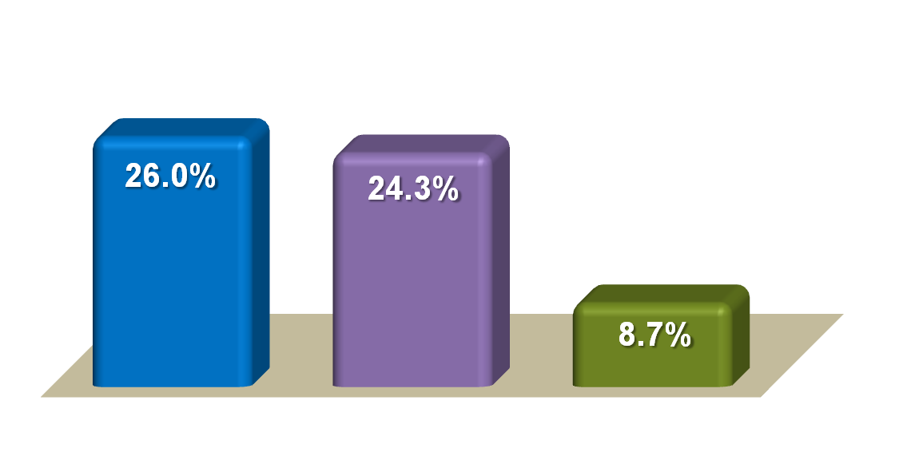
The pilot program showed a trend toward reduced hospitalizations with nutrition intervention
Collaboration
Awareness through education and training
Plan of action
Client self-management
Efficiency with process
National Average†
Bayada Average*
Bayada Pilot Average*
†medicare.gov/homehealthcompare/search.aspx (data as of 10/11)
*For 7 participating locations
Notes:
KEY TAKEAWAY: Bayada Nurses achieved significant reduction in hospitalizations with nutrition therapy
SPEAKER’S NOTES:
In the 7 offices that participated in the case study only 8.7% of patients at nutritional risk were hospitalized in the 6 month testing period
This is such an important finding because the average rate of hospitalizations in patients not receiving oral nutrition supplements as part of their nutrition therapy for these offices is 24.3%
The keys to success:
Collaboration – between health care professionals, especially the clinical leadership team, and Abbott Nutrition, all of whom recognize the role nutrition can play in improving outcomes at home
Awareness through education and training – of the staff, patients and caregivers about the importance of good nutrition and who is at nutritional risk
Action – having a plan of what to do for patients at nutritional risk
Client self-management – nutrition education tools to help improve patient self-management of their disease to make them successful in their care and remain successfully independent at home
Efficiency – incorporating the program into the existing process to garner support among field clinicians and make it more efficient and convenient
PROBING QUESTION:
How would similar results effect your agency?
How would similar results allow you to achieve your agency’s specific set goals?
TRANSITION:
Now I’d like to discuss how we can design a program to impact your agency’s outcomes.

Slide 29
Community-Based Care Transitions
and the PASS Program

Slide 30
Community-Based Care Transition Program (CCTP) Overview
The CCTP, mandated by section 3026 of the Affordable Care Act, provides funding to test models for improving care transitions for high risk Medicare beneficiaries.
Program will run for 5 years beginning April 12, 2011
Applicants will be awarded 2-year agreement that may be extended on an annual basis for the remaining 3 years based on performance.
Goals of CCTP
Improve transitions
Improve quality of care
Reduce readmissions for high risk beneficiaries
Document measureable savings

Slide 31

Community-Based Care Transition Program (CCTP) — Who Qualifies?
Hospitals with high readmission rates that partner with community-based organizations (CBOs).
CBOs that provide care-transition services
In selecting CBOs to participate in the program, the statue requires that preference be given to:
“Administration on Aging (AoA) grantees that provide care transition interventions in conjunction with multiple hospitals and practitioners and/or entities that provide services to medically-underserved populations, small communities, and rural areas.”

Slide 32

Community-Based Care Transition Program (CCTP) Requirements for Application
Target population must be identified.
Describe a plan to reduce hospital readmissions.
Describe the implementation of proposed care transition interventions that will be integrated upon hospital discharge.
Monthly intervention data must be clearly defined.
Present operational protocols detailing: internal monitoring process, management and delivery of care transition services, and financial controls for Medicare payments.
Notes:
Abby

Slide 33

Post Acute Support System PASS Sustainable Community Model
CBO Partnership Model
Identify and partner with community-based organizations
Area Agencies on Aging
Aging and Disability Resource Centers
Community Living Programs
Operational partnerships to provide
Coaching staff
Home and community based referrals and coordination of services
Community education
Existing successful partnerships
Florida AoA
Michigan AAAs
Ohio AAAs
California CBOs
Notes:
Transition to ILS.

Slide 34
Post Acute Support System — PASS® Product Information
Program Origins & Focus
PASS® focuses on the care transition between the institutional setting (Acute inpatient, Sub-Acute, Nursing Home) back to the home & community setting.
Based on Care Transition Intervention (CTISM) Program developed by Dr. Eric Coleman, University of Colorado.
Care Transition program designed to coordinate and manage the transition of individuals from the Acute Inpatient setting to the Home & Community Setting.
PASS is not replacement for case management, discharge planning or home health.
PASS is patient advocacy, education, communication and coordination.
Operating Model
Driven by the PASS Coach, supported by PASS Care Coordinators and PASS system technology.
Interaction with patient:
Face-to-face during inpatient admission¹
Face-to-face at Home post discharge (48 – 72 hours)
Telephonic, day 2, 7, 14, 21 and 30 post discharge
1. PASS Coaches are assigned by facility and visit that facility each day.

Slide 35
PASS® Core Components
Medication Self Management – patient is knowledgeable about medications and has a medication management system. Home Visit: Face-to-face medication reconciliation.
Nutrition Management – patient is knowledgeable about nutrition status, meal planning and diet as it relates to chronic conditions. Home Visit: Home based nutrition assessment, kitchen and environment evaluation, daily meal plan.
Personal Health Record – patient understands and utilizes a PHR to facilitate communication and ensure continuity of care plan across providers & settings. Home Visit: Reconciliation of PHR data, education.
PCP and Specialist Physician Follow-Up – patient schedules and completes follow-up visits with PCP / Specialists & is empowered to be an active participant in these interactions. Home Visit: Schedule and coordinate PCP follow-up visit, direct coordination if necessary.

Slide 36
PASS® Core Components (cont’d)
Red Flags / Signs & Symptoms – patient is knowledgeable about indicators that suggest his/her condition is worsening and how to respond. Home Visit: Education and coordination – recognition and response.
PLUS…
Home and Community Based Services – identification and coordination of home and community based services to assist in care transition and maintain patient independence. Home Visit: Identification and referral, coordination of services.
Personal Health Record
Physician Follow-Up
Red Flags Signs & Symptoms
Nutrition Management
Medication Management

Slide 37
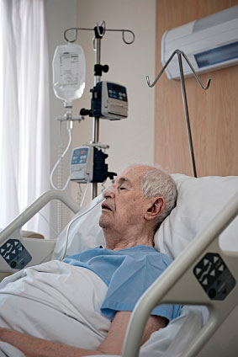
The Role of Nutrition in CCTP
Poor nutrition, or malnutrition, leads to poorer health outcomes including slower healing rates, increased risk for medical and surgical complications, delayed recovery, increased length of stay, and increased readmission rates and mortality.
Sullivan DH. Risk of early hospital readmission in a select population of geriatric rehabilitation patients: The significance of nutritional status. J Am Geriatr Soc. 192;40:792-798

Slide 38

PASS Nutrition Support
The Nutrition Support that ILS offers through it’s
PASS program includes:
10 frozen Home Delivered Meals (condition appropriate)
Post DC survey that provides additional coaching to good post DC behavior such as: visiting PCP or Specialist, understanding DC instructions.
The telephonic outreach is an emotional untellable support..
Provides another opportunity to share status updates that can lead to better Care Transition

Slide 39
Summary
Many patients suffer from poor nutrition, especially older adults
Malnutrition is linked to negative outcomes, including readmissions
Nutrition screening and intervention can improve outcomes
Providing adequate nutrition care across healthcare sectors can improve care transitions, improve quality of care, decrease costs and help prevent avoidable readmissions

Slide 40
Any questions?
Thank you!

